Slide 1


Why not to Outsource?
www.coolumba.com

Slide 2




Who we are?
Сoolumba always tries to have exceptional results with its Outsourcing service in particularly our software engineers have vast experience with challenging and innovative projects.
SOFTWARE
DEVELOPMENT
DIGITAL MARKETING
FULL-SCALE OUTSOURCING CALL CENTER

Slide 3
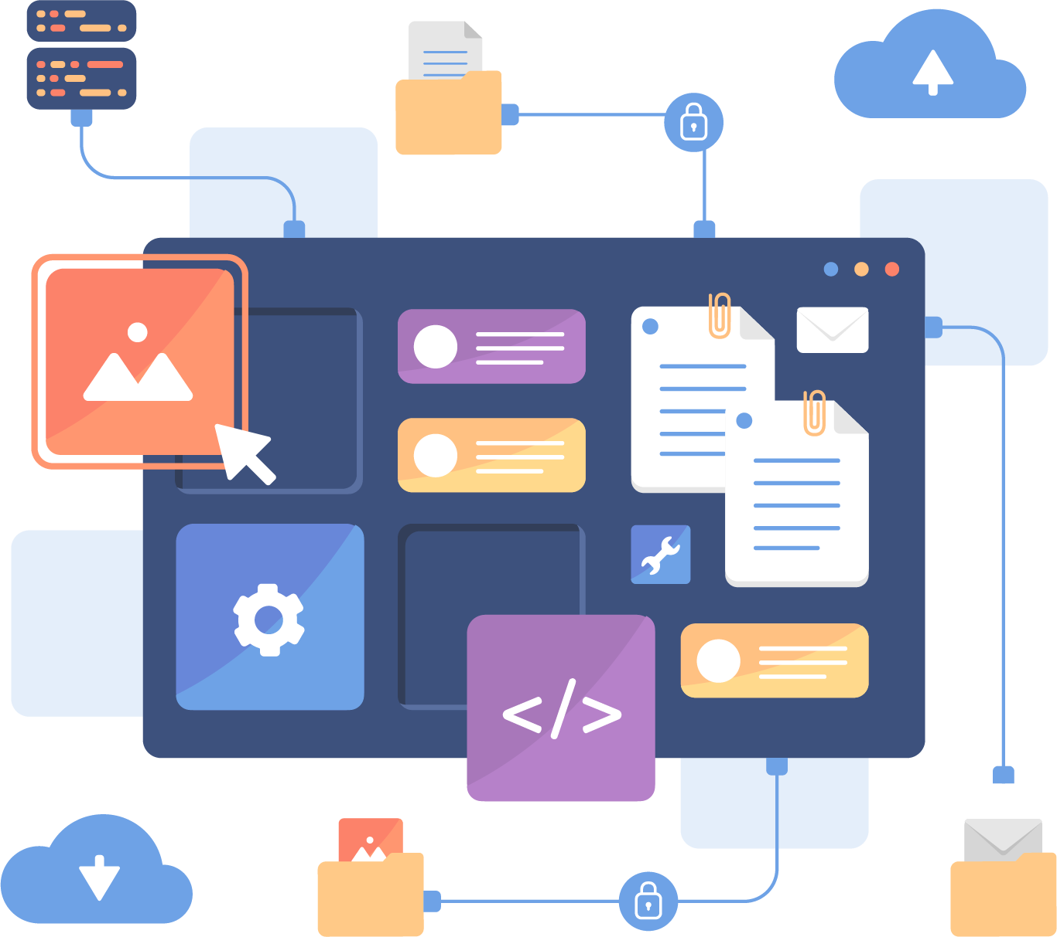
Software Development
The team comprises of more than 20 highly qualified specialists with practical experience in
Web and mobile app development (Front, Back-ends)
QA testing
Data analytics and Dashboarding
Cyber Security
IT Project planning and monitoring
Robotic Process Automation (RPA) (Python, UiPath etc);

Slide 4

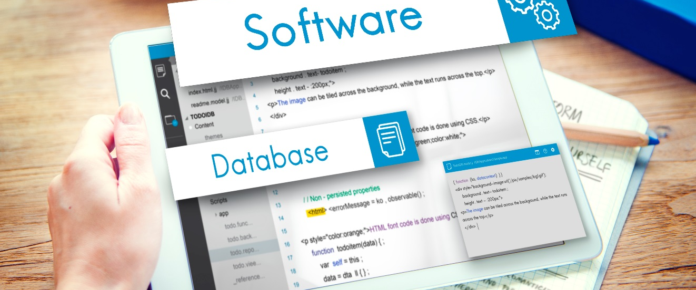
Software Development.
Coolumba skills
Professional dedicated software developers in each area
< >
{ }
Web development stack, Client side, Frontend technology stack
JavaScript, HTML5, CSS3, Vue.js, Angular, React, PHP, LESS, PostCSS, RequireJS, ES6 Modules, Webpack, Gulp, jQuery, REST, SVG, Bootstrap
Web development stack, Server side, Backend Tech stack
Node.js, Python, C++
Java SE/EE, Servlets/JSP, JavaFX, Google Web Toolkit (GWT), Laravel, Yii Framework, Rest Api
Data Storages (relational and NoSQL)
PostgreSQL, MySQL, MongoDb,
Microsoft SQL Server
CMS
Content Management System (CMS)
Wordpress, Drupal, Joomla, 1C Bitrix
WooCommerce,

Slide 5






Software Development.
Recent projects
Municipal organization web portal for e-government
Developed nationwide online portal using cutting edge tools and technology where Government agencies was able to provide G2C and G2B services.

Slide 6



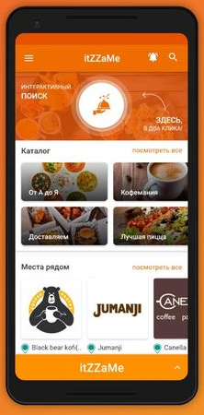
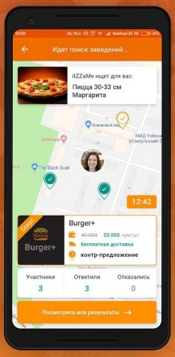
Software Development.
Recent projects
Сafe`s and restaurants personal service
A backend of a mobile application for ordering food from cafes and restaurants has been prepared.

Slide 7



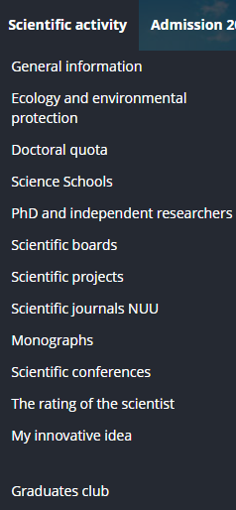
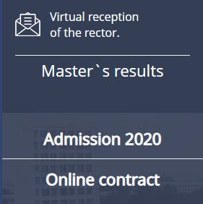

Software Development.
Recent projects
University educational website
The developed university site became an almost full-fledged educational institution located on online. The developed product become go-to platform for every student during pandemic lockdown.

Slide 8

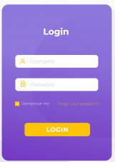
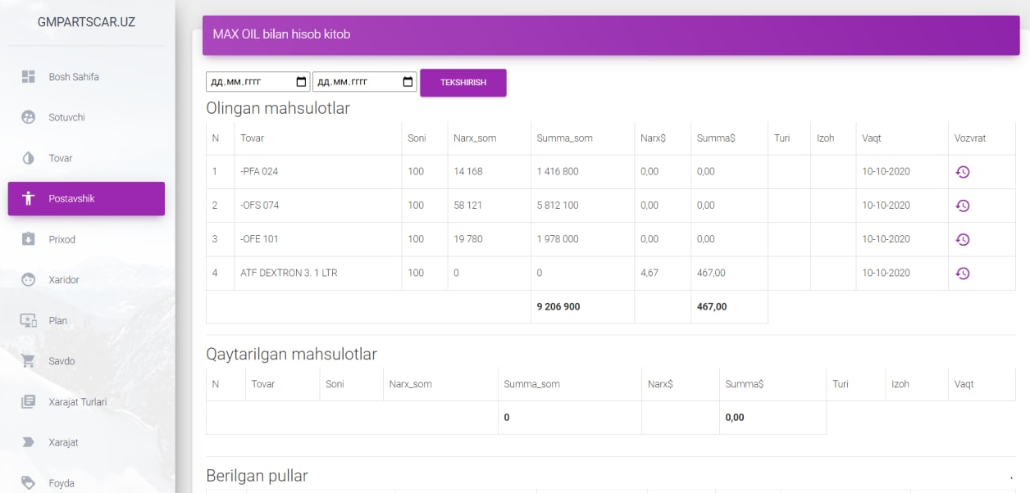
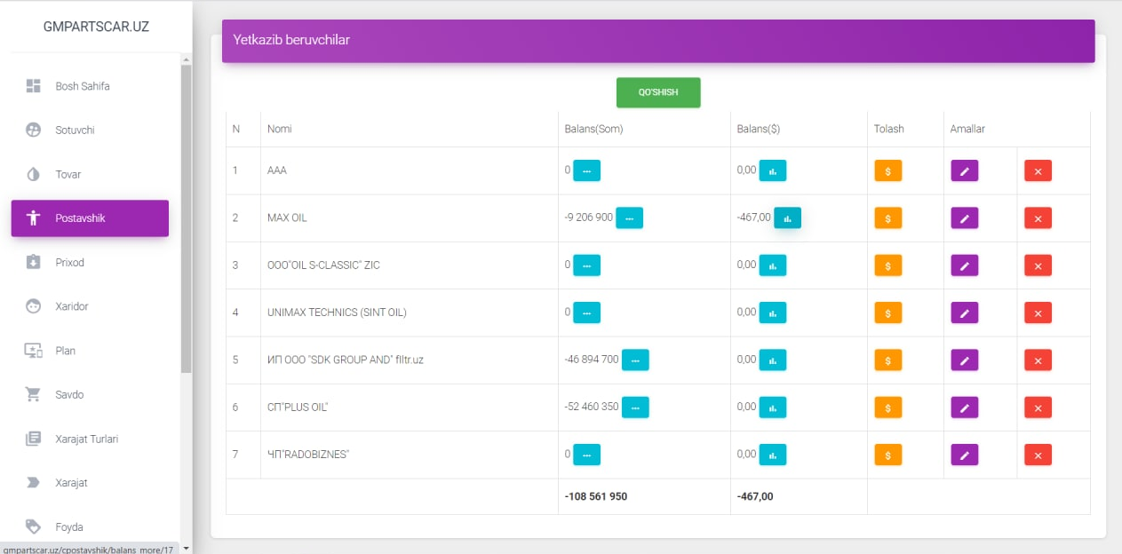
Software Development.
Recent projects
Automated system between suppliers and dealers
Internal accounting system for GM parts to customers/dealers.
In the system, each manufacturer can separately keep track of their products, orders and status.

Slide 9
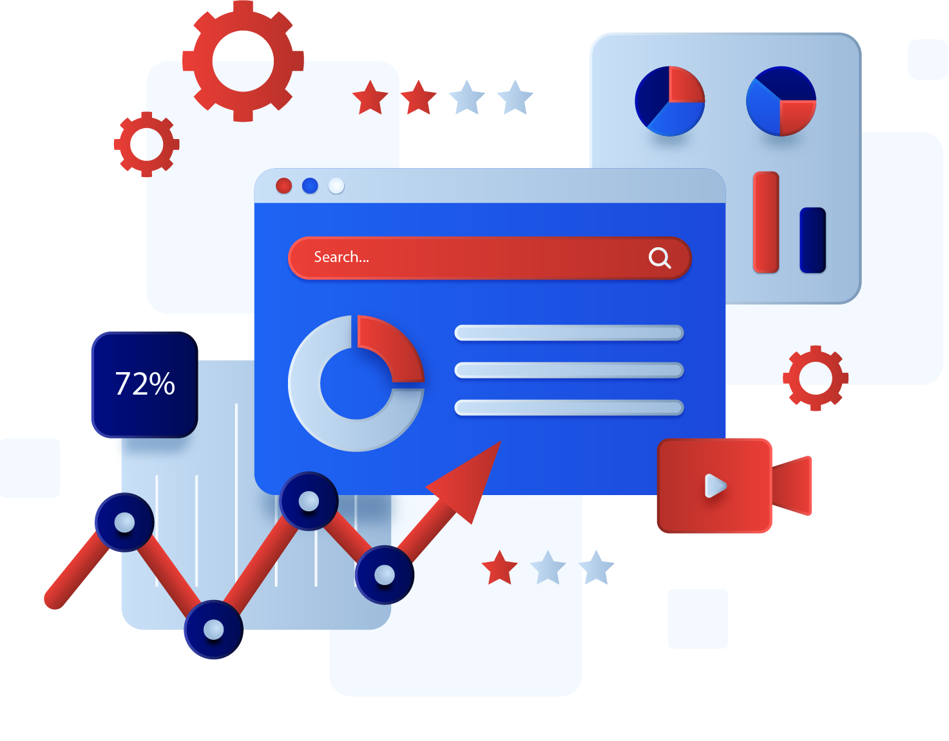
Digital Marketing
What else can we outsource from you?
Digital Marketing

Slide 10

Full-scale outsourcing call center
How else can we help your team for minimum cost?
Outsource the call center

